Slide 1

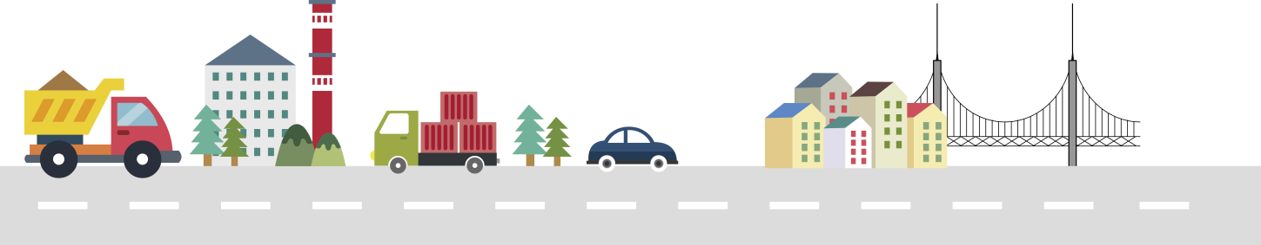

I3CDE Penang
Development of Room Occupancy Detection Device
For Smart-FM
2019. 7. 8
*YooSeok, Jung; TaeWook Kang
*yooseok@kict.re.kr
Notes:
Hello, this is 정유석 from KICT Korea.
Let me tell you about room occupancy detection, which I have been interested in.

Slide 2

Contents
1. Background
2. Framework
3. IoT Device installation
4. Data collection
5. Deep Learning condition
6. Deep Learning Result
7. Conclusion
1
Notes:
In this research, IoT device is fabricated and collect the data. Than analyzed using Deep learning.

Slide 3
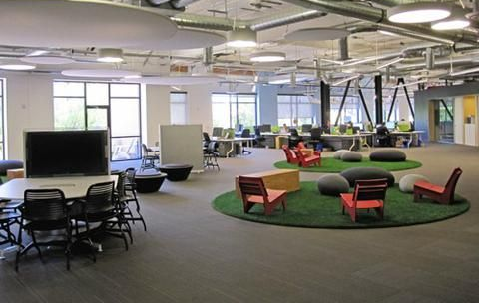

1. Background
The way and meaning of the office is changed
Shared offices and open offices become common
Furthermore, flexible working is introduced
How to maintain office space must be changed
[ Shared and Open office ]
[ Flexible working ]

Slide 4
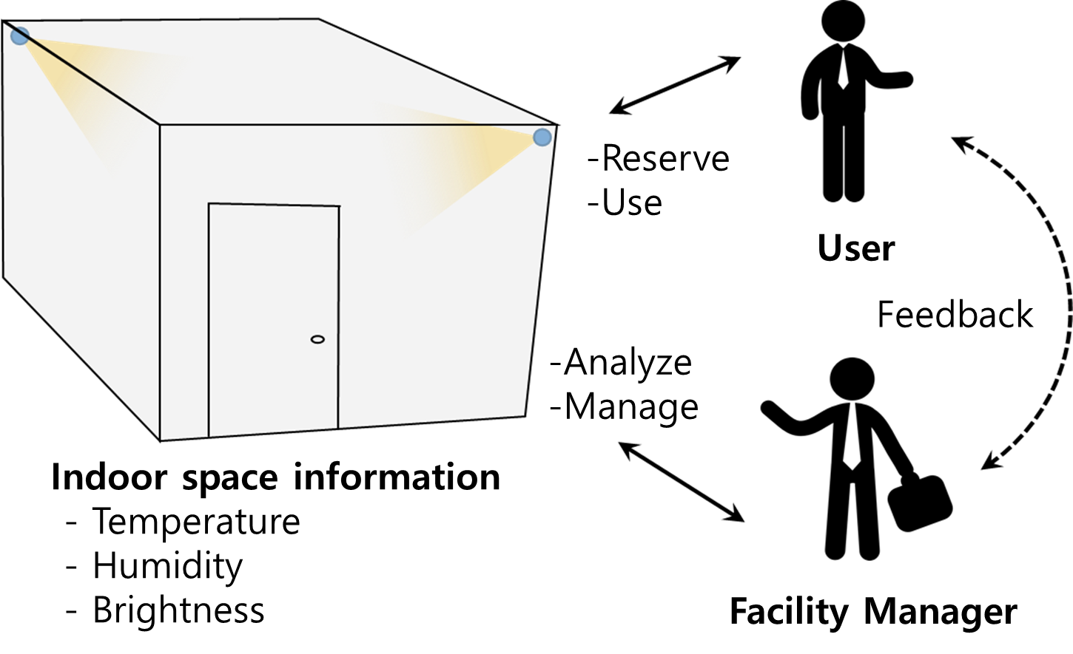
1. Background
Notes:
So, new type of office management should be introduce.
Instead of User occupy the space and self-managing, the sensors are collecting the indoor condition automatically and give an information to Facility manager.
Than facility manager is able to manage the office easily.

Slide 5



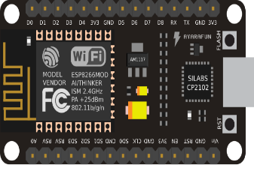
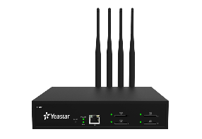





2. FrameWork
Internet of Things
Cloud
NodeMCU
Room occupancy
WiFi
Gateway
Brightness
Deep Learning
Big Data
Temperature
Humidity
Deep learning for time-series data
Multi layer perceptron
LSTM (Long short-term memory)
Notes:
This research propose the framework as shown.
Space conditions are collected using IoT device.
Than it become a Bigdata on the Cloud.
Deep learning can be adopted to the bigdata.
If a large difference is found, between the actual data and the predicted data using deep learning, there may be an issue in the space.

Slide 6
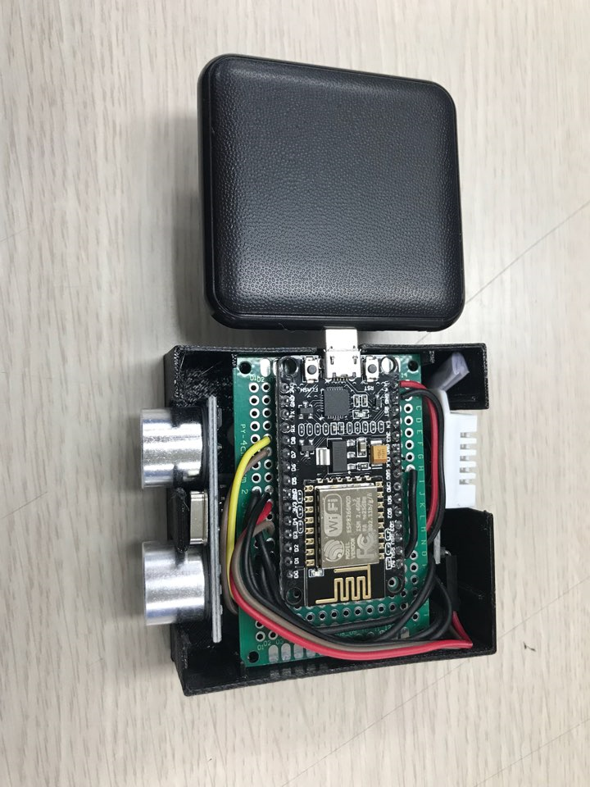
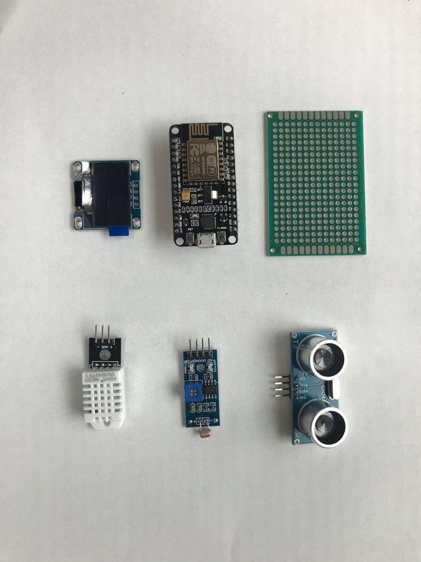
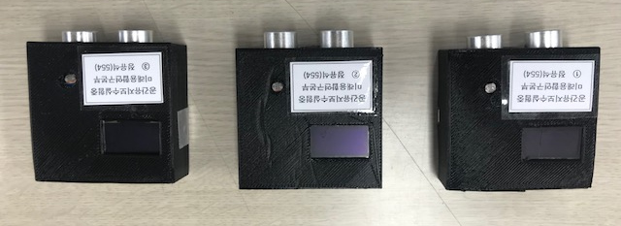
3. IoT Device installation
Notes:
IoT devices are fabricated using NodeMCU.

Slide 7
3. IoT Device installation
Define libraries
<DHT.h>, <ESP8266WiFi.h>, <WiFiClient.h>, <ThingSpeak.h>, <Wire.h>, <Adafruit_GFX.h>, <Adafruit_SSD1306.h>
Connect WiFi
i=0
i=0
Data aquisition
i=0
Temperature, Humidity, Brightness (1s/s)
i+1
i=20
Data storage
Send the data to cloud service (+10sec)
Notes:
Open source libraries are mainly used.
Temperature, humidity, and brightness data are collected every second.
After 20 data were collected, statistical processing was performed to transmit them to the cloud.

Slide 8
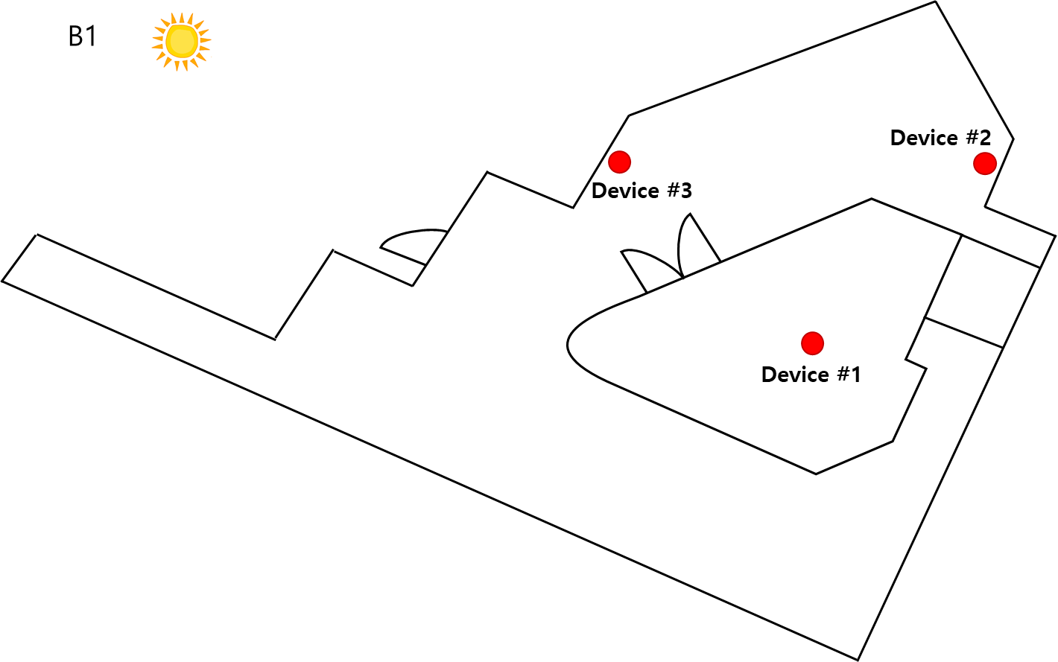
3. IoT Device installation
Notes:
3 IoT devices are installed at underground floor of KICT.

Slide 9
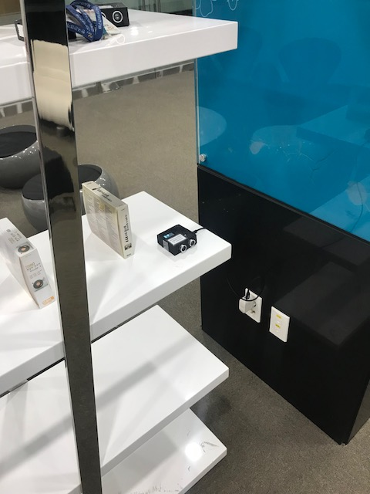
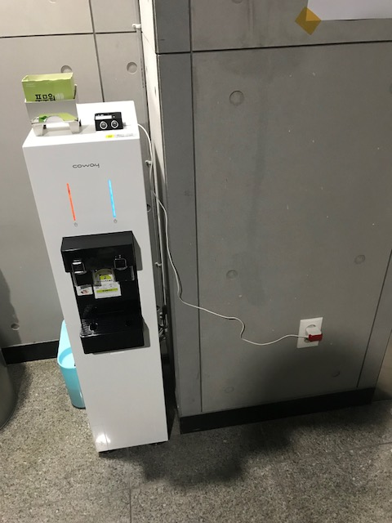
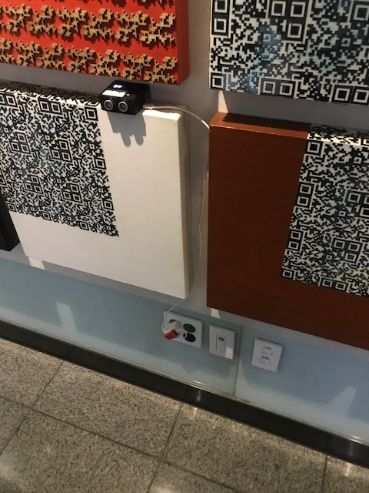
3. IoT Device installation
[ Device 1 ]
[ Device 2 ]
[ Device 3 ]

Slide 10
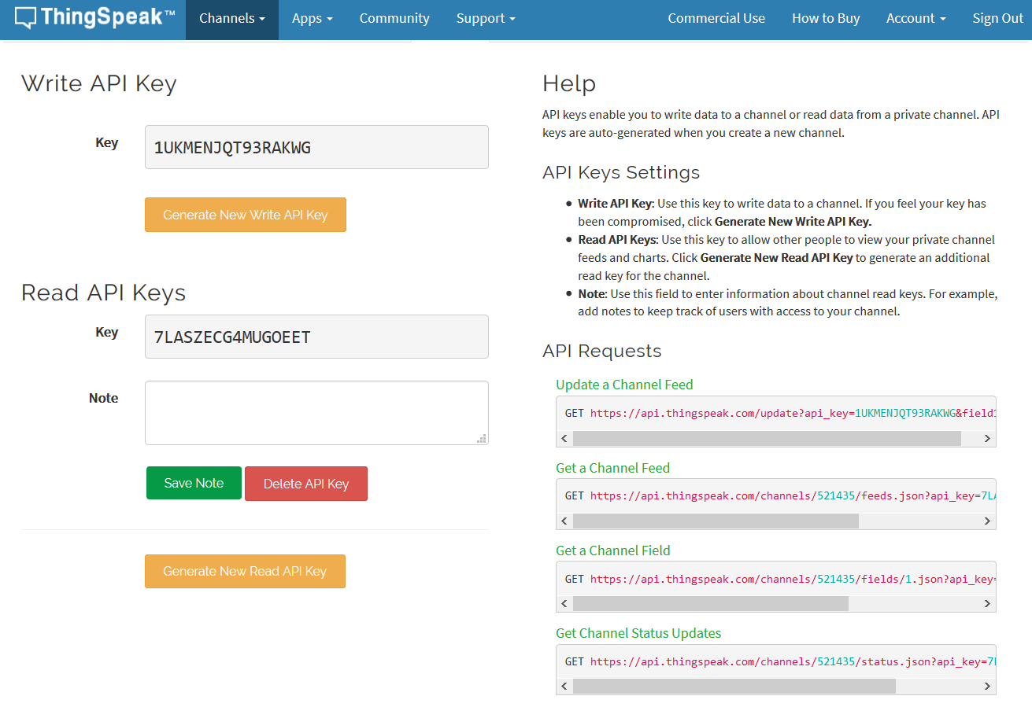
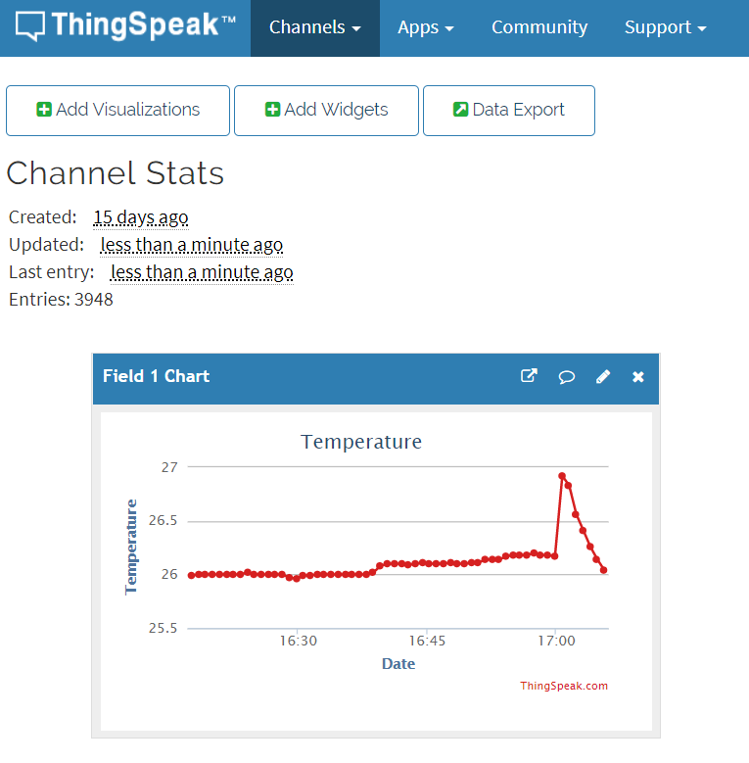
3. IoT Device installation
Notes:
Data in collected using Thingspeak which is IoT platform.

Slide 11
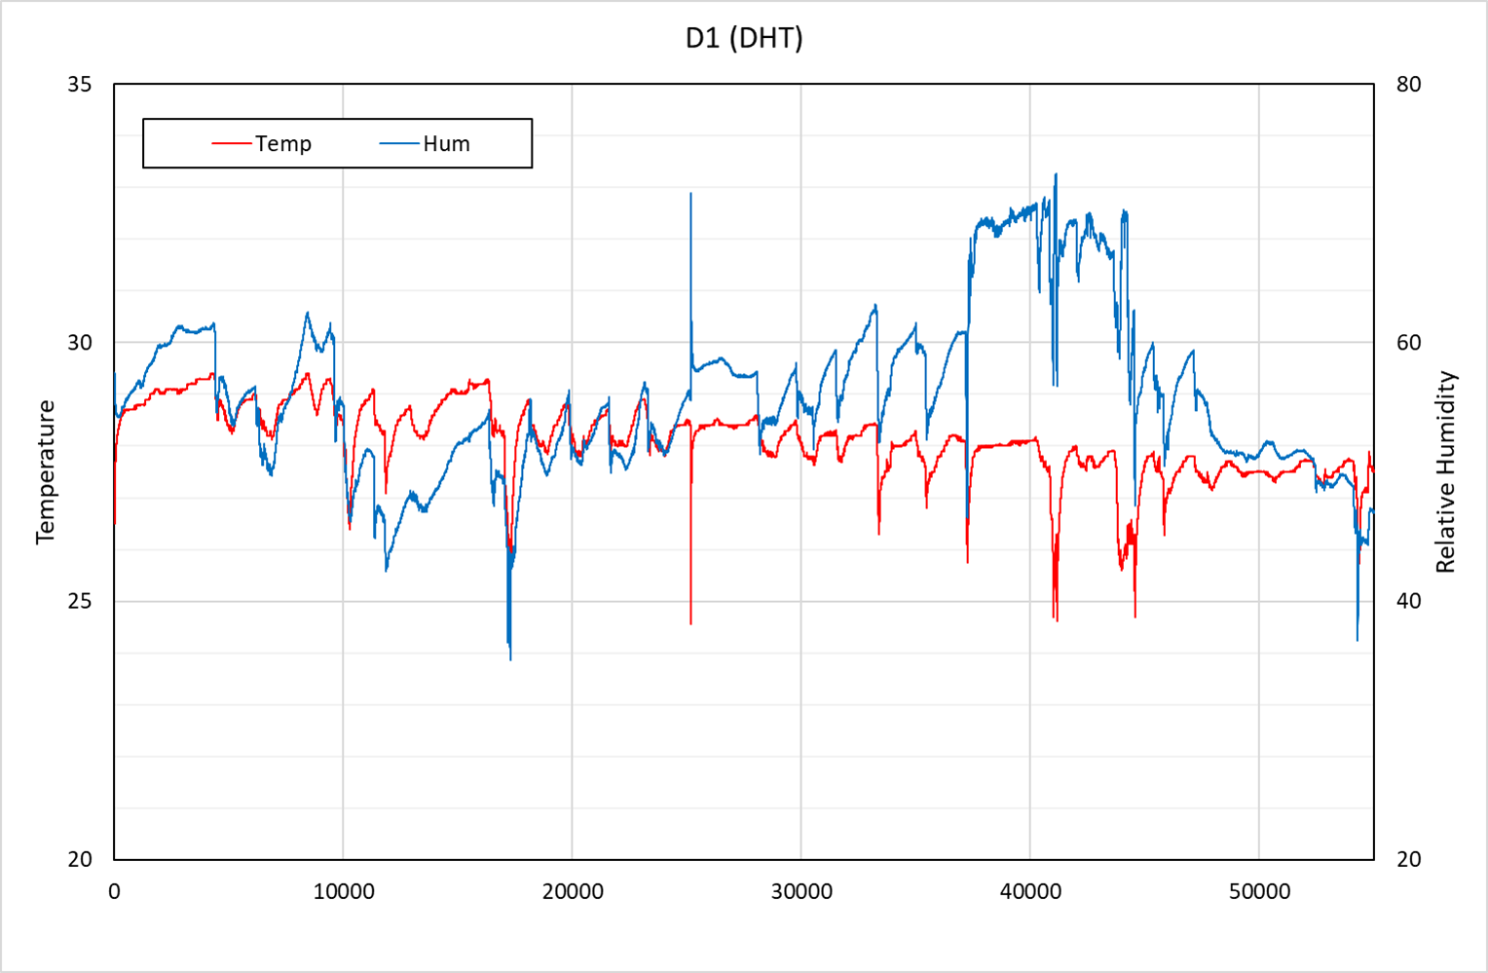
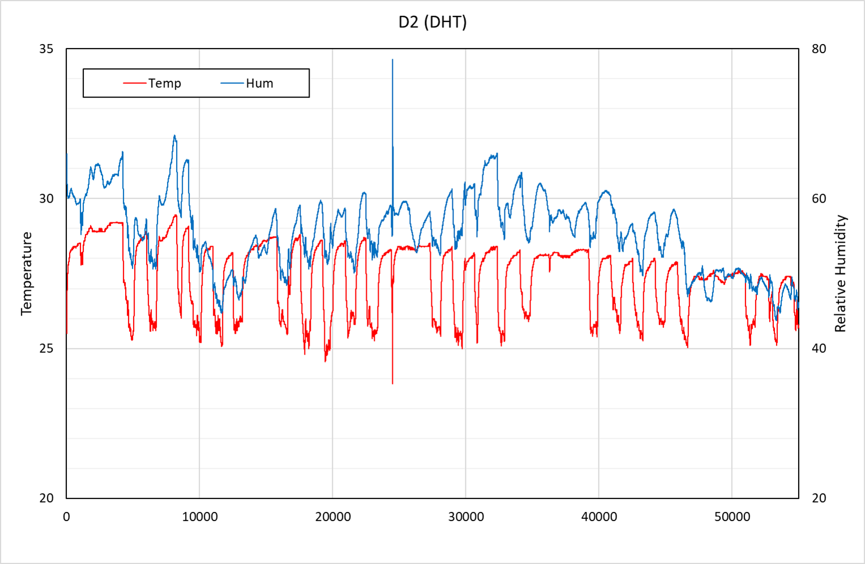
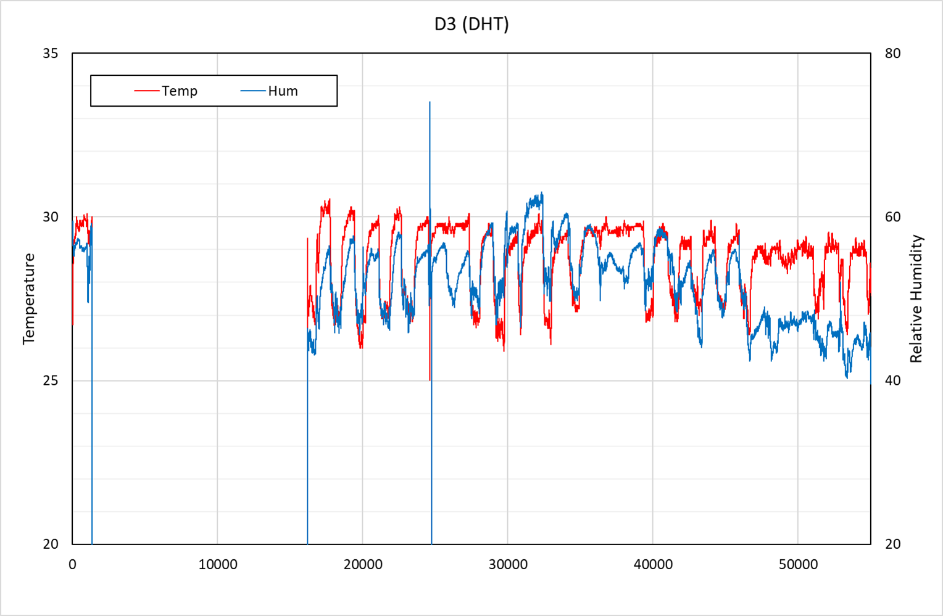
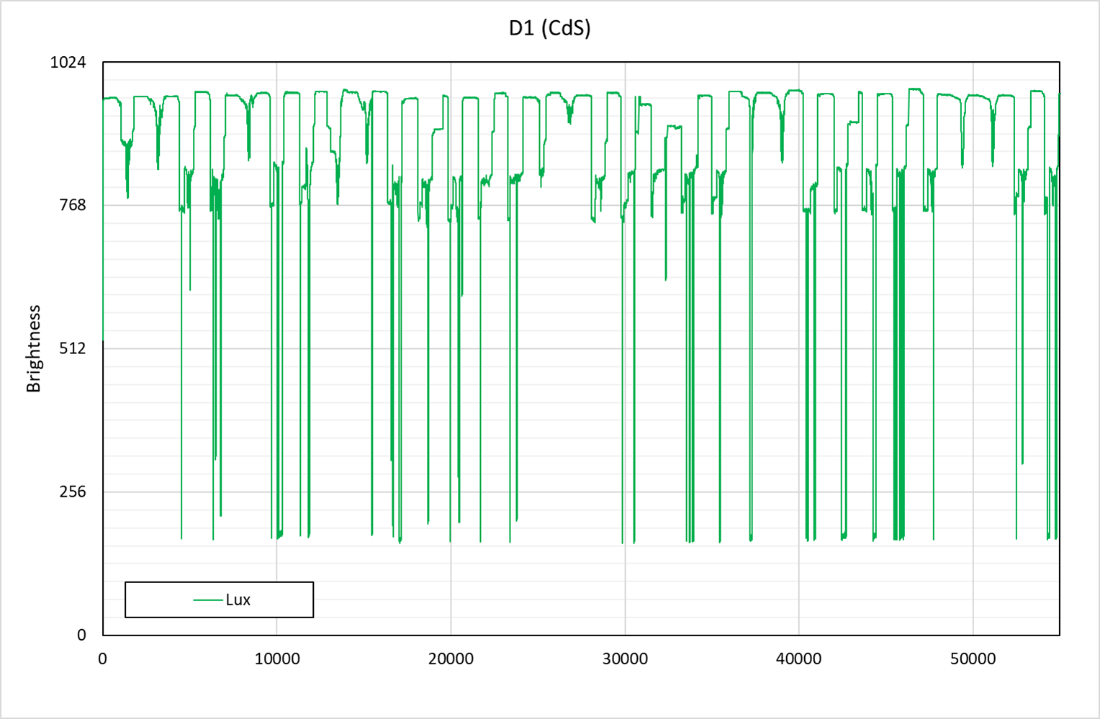
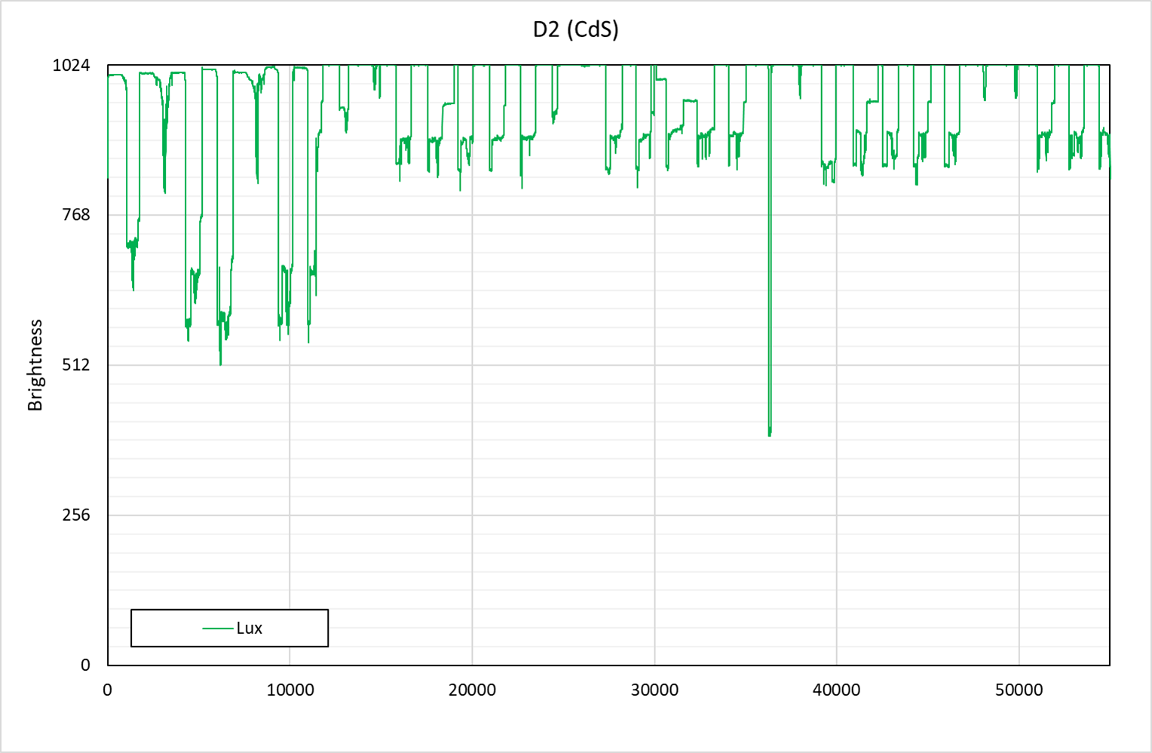
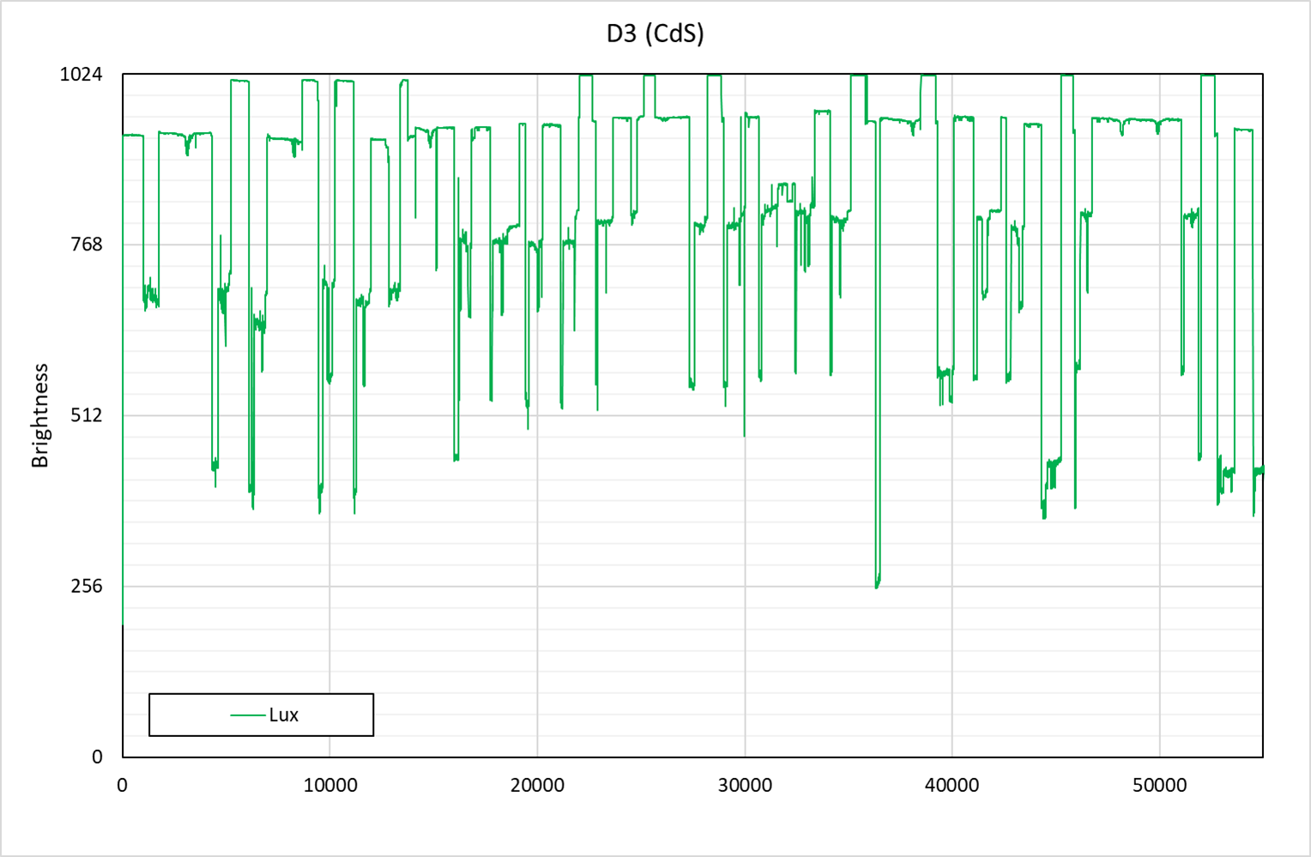
4. Data Collection
Notes:
Due to the air-conditioning system, Temperature and Humidity is not change much.
The brightness show more data change and patterned.
So, brightness data is analyzed first.

Slide 12
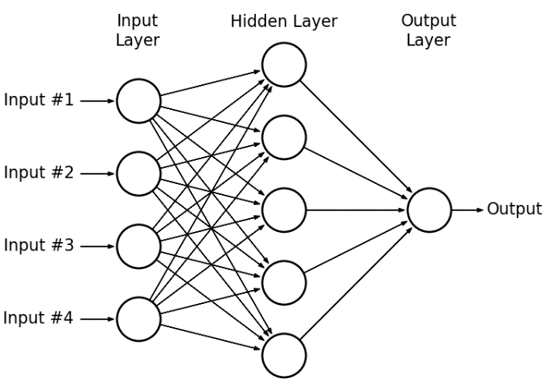

5. Learning condition
Environment : Google Colab(Keras)
Model : Multi Layer Perceptron
Condition : 3-Dense Layer(128neuron) + Output layer(1neuron)
Activation : relu
Data set : 55277 = 40000(train set) and validation set
4 input features(Hour, Minute, Second, Brightness)
epochs=50, batch_size=256
Notes:
Learning Condition.
I used Keras at google colab environment.
Multi layer perceptron model is adopted.
More than 50-thousand of brightness data is using for learning and validation.

Slide 13
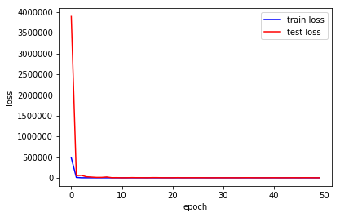
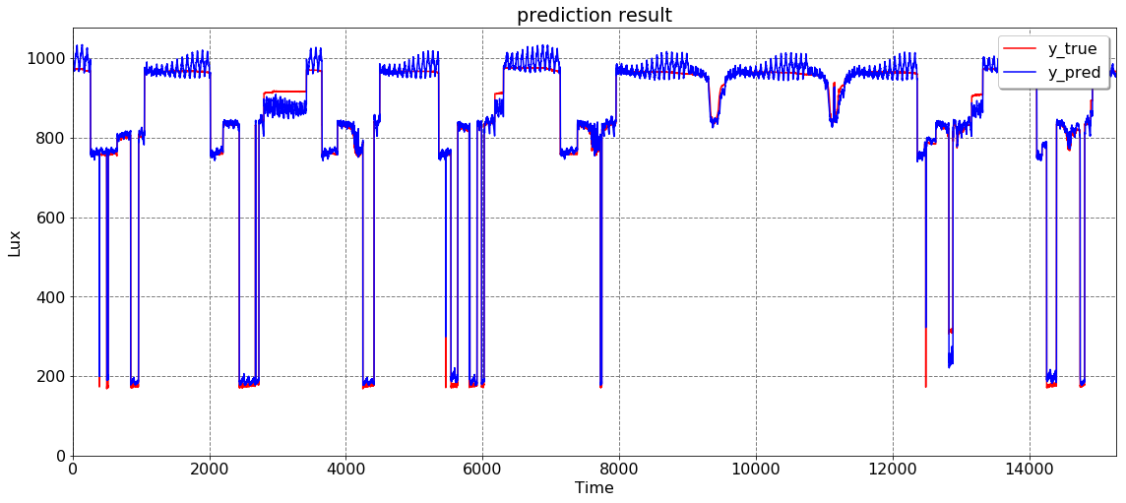
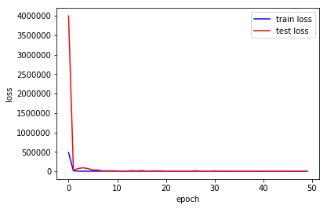
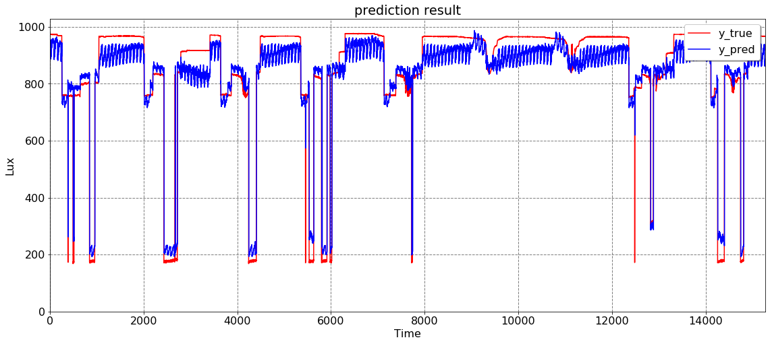
6. Learning results
[1 min prediction] Train Score: 780.47, Test Score: 1090.23, MAPE: 2.40
[5 min prediction] Train Score: 4606.68, Test Score: 5966.68, MAPE: 8.23
Notes:
Here are learning results.
I increases the prediction time from 1-minute to 25minute.
As you can see, the MAPE(error) is increases the longer the prediction time.

Slide 14
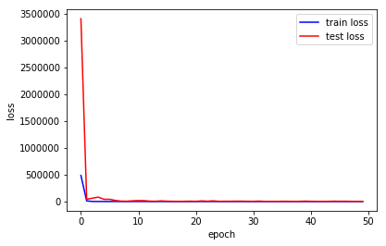
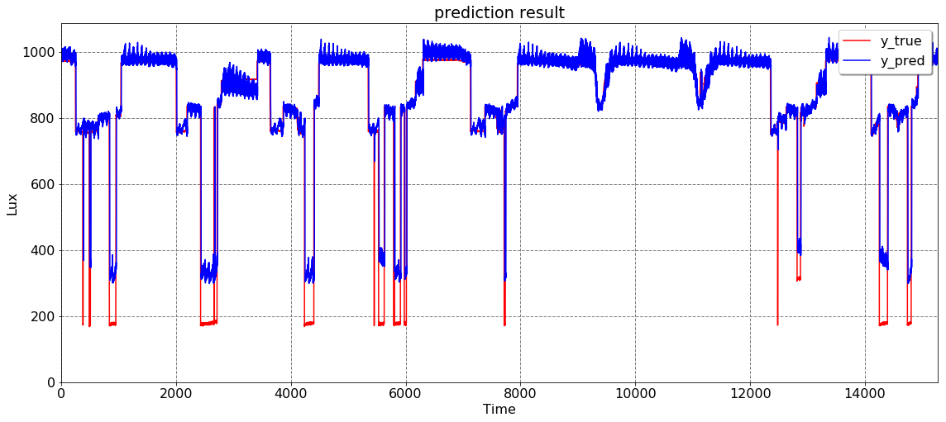
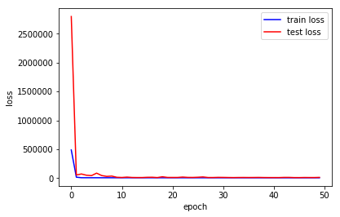
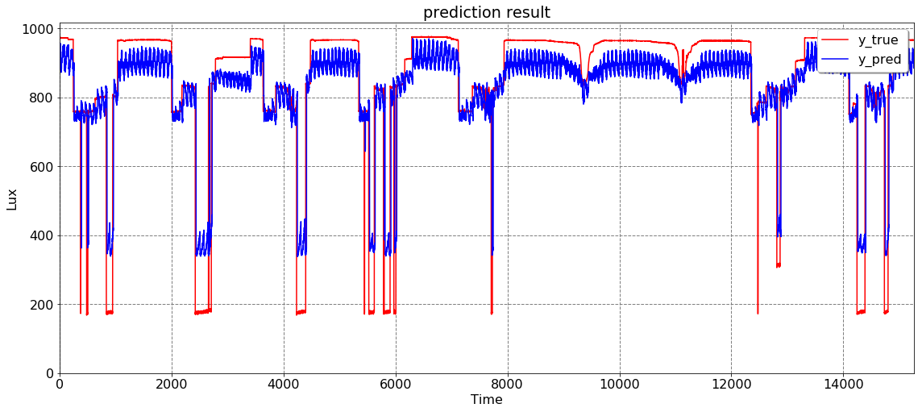
6. Learning results
[10 min prediction] Train Score: 3893.21, Test Score: 6977.88, MAPE: 10.47
[15 min prediction] Train Score: 6623.33, Test Score: 10181.30, MAPE: 13.73

Slide 15
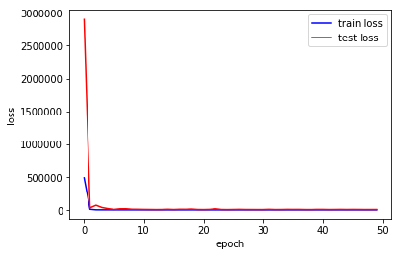
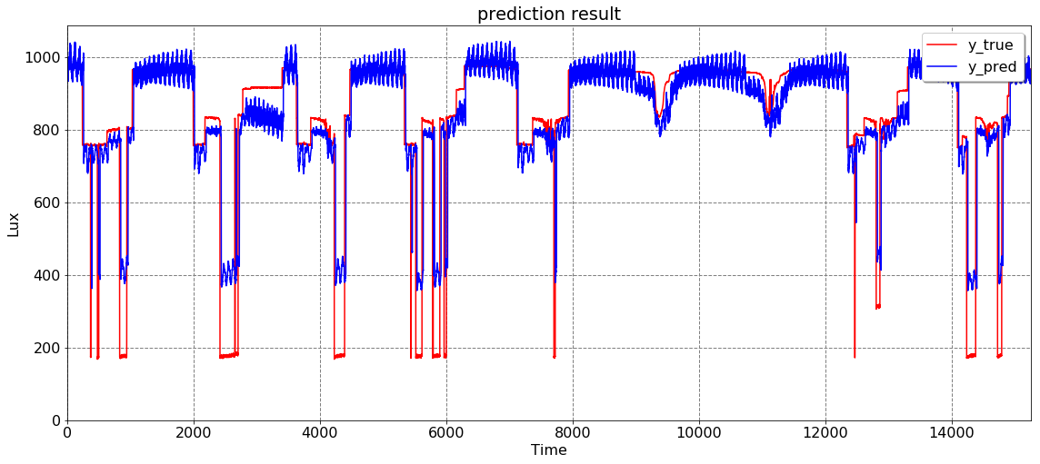
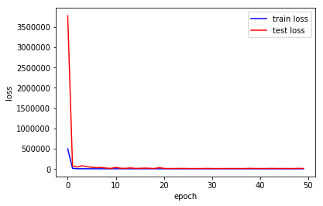
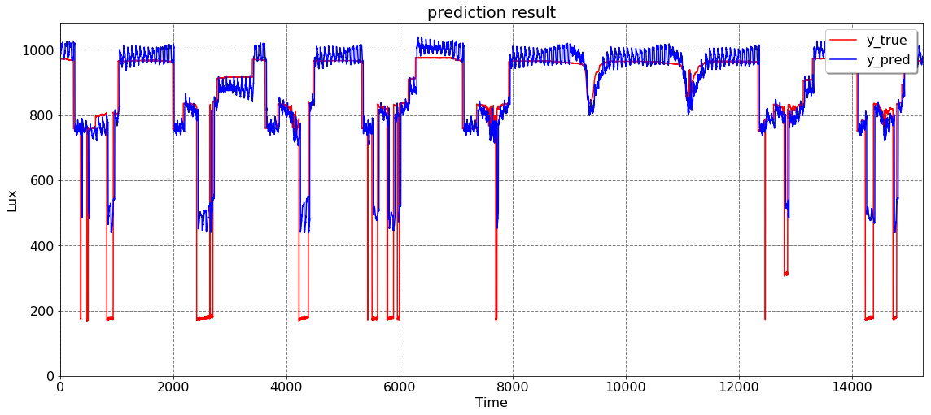
6. Learning results
[20 min prediction] Train Score: 7536.59, Test Score: 12577.71, MAPE: 16.30
[25 min prediction] Train Score: 7903.24, Test Score: 15129.51, MAPE: 18.89

Slide 16
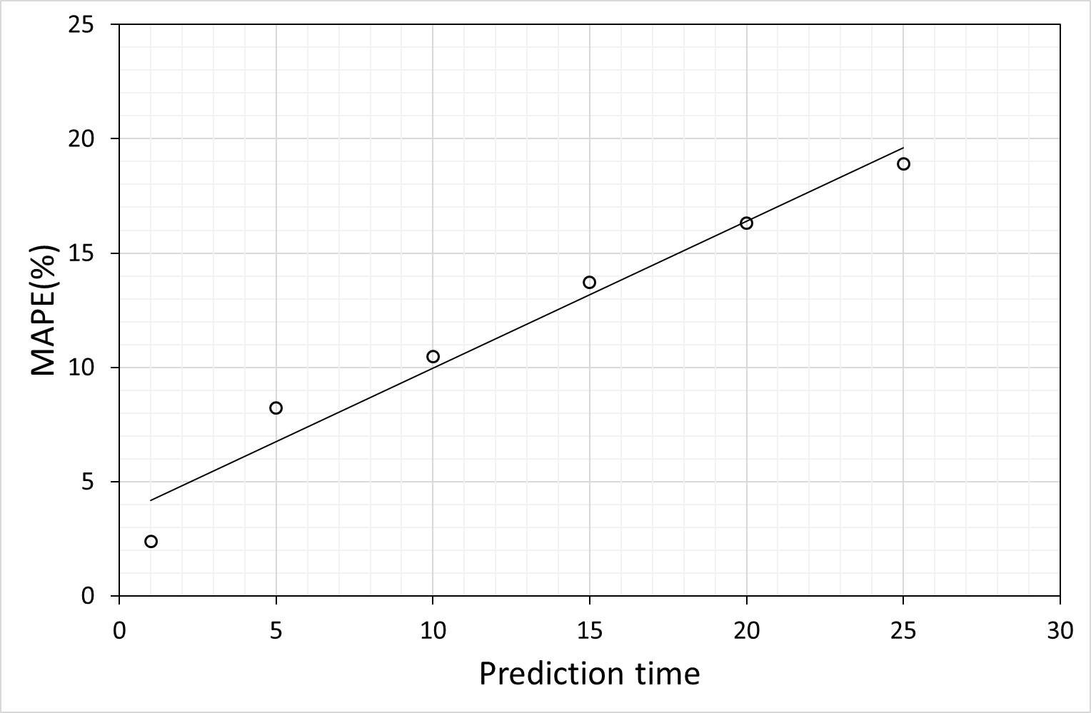
6. Results
Notes:
The MAPE is linearly increased.
So If we try to predict lower than the 10 minute of brightness , acceptable Error is occurs.

Slide 17
7. Conclusion
Verified the possibilities of an office maintenance framework utilizing IoT and deep learning.
10% of MAPE is occurs when the brightness after 10 minutes is predicted
MAPE(error) is increased the longer prediction time.
Further research plan :
Optimized the input features
Adopt the LSTM model
Analyze the other data(Temperature, Humidity, Device #2 and #3)

Slide 18
Thank you

Slide 19
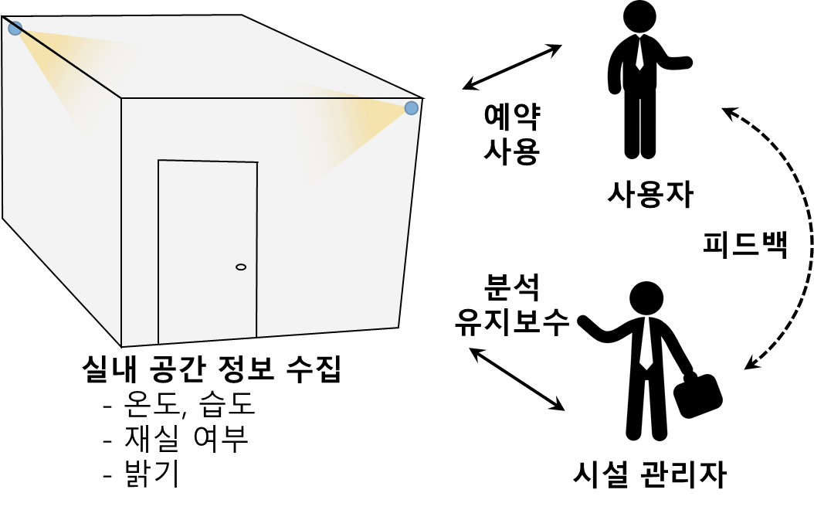
2. Background
-Reserve
-Use
User
Feedback
-Analyze
-Manage
Indoor space information
- Temperature
- Humidity
- Brightness
Facility Manager

